Slide 1
PROJECT TITLE: Health Nexus
PIP2001 Capstone Project
Review-1
Batch Number: 257
Roll no Name
20211ISE0003 Mohit K
20211ISE0006 Harsha S B
20211ISE0029 Sanjay R
20211ISE0054 Nikhil M S
Under the Supervision of,
Prof. Jinesh V N
School of Computer Science and Engineering
Presidency University
Name of the Program: Information Science & Engineering
Name of the HoD: Dr. Pallavi R
Name of the Program Project Coordinator: Prof. Jinesh V N
Name of the School Project Coordinators: Dr. Sampath A K / Dr. Abdul Khadar A / Mr. Md Ziaur Rahman

Slide 2
Introduction
Developing a web application for Doctors and Researchers to access the patient’s data in EHR (Electronic Health Records) database.
We are creating two interfaces in this application one for doctors and another one for researchers.
Doctors interface will have functionality to diagnosing rare diseases by using symptoms of patient. So that doctors can give required treatment as soon as possible.
In researchers interface researchers can query the database to generate patient similarity matrices, allowing them to conduct studies like patient outcome comparisons and case-control research.
Machine learning algorithms are applied to cluster patients based on their medical conditions to identify patterns and similarities between cases.

Slide 3
Literature Review
Sl.no | Title of the paper | Authors | Technology used | Results | Limitations
1 | Clustering Algorithms for Healthcare: An Overview and Practical Applications in Patient Grouping | Kevin Davis 2019 | K-means clustering, hierarchical clustering, Gaussian mixture models | K-means clustering effectively grouped patients with similar conditions. | Difficulty selecting optimal cluster number and handling outliers.
2 | Electronic Health Records and Machine Learning: Improving Patient Diagnosis and Treatment Recommendations | Lisa White 2020 | Random forests, support vector machines (SVM), feature engineering using EHR | Improved diagnostic accuracy by 15% with machine learning models on EHR data. | Challenges integrating heterogeneous data types from EHRs.
3 | Patient Similarity-Based Clinical Decision Support Systems: Methods and Challenges | James Taylor 2022 | Patient similarity algorithms, cosine similarity, distance metrics, CDSS integration | Improved case matching and personalized treatment recommendations using similarity metrics. | High computational complexity and need for real-time processing.

Slide 4
Literature Review
Sl.no | Title of the paper | Authors | Technology used | Results | Limitations
4 | Evaluation of Patient Similarity Metrics for Clinical Research and Decision Making | Andrew Wilson 2023 | Cosine similarity, Jaccard similarity, Euclidean distance, feature extraction from EHR | Cosine similarity was most effective in matching patients with similar conditions. | Sensitivity to noisy data and difficulty interpreting clinical relevance of scores.
5 | Predictive Analytics in Healthcare: Machine Learning for Risk Stratification and Patient Clustering | Chris Mille 2021 | Risk stratification models, clustering algorithms (DBSCAN, k-means), EHR data | Risk stratification significantly reduced hospital readmission rates. | Scalability issues with large datasets and mixed data types.
6 | Clinical Trial Design Using Machine Learning: Patient Clustering for Personalized Interventions | Michelle Rogers 2022 | K-means clustering, hierarchical clustering, patient subgroup identification for clinical trials | Improved subgroup identification for clinical trials, leading to higher success rates. | Bias due to incomplete EHR data and overfitting in small patient groups.

Slide 5
Literature Review
Sl.no | Title of the paper | Authors | Technology used | Results | Limitations
7 | Ethical Considerations in Machine Learning for Healthcare: Bias, Privacy, and Fairness in EHR-Based Models | Thomas Parker 2020 | Ethical frameworks, bias detection algorithms, privacy-preserving machine learning | Identified and proposed solutions for biases in ML models trained on EHR data. | Balancing patient privacy and comprehensive data for model training.
8 | From Data to Decisions: How Electronic Health Records and AI Can Transform Clinical Practices | Emma Howard 2019 | AI-driven decision support systems, machine learning on EHR data, real-time patient clustering | AI-driven real-time recommendations improved treatment precision. | Integration challenges with existing hospital systems and resistance to AI adoption.
9 | Applications of Machine Learning in Healthcare: Patient Similarity and Predictive Modeling Using EHR Data | John Smith 2021 | Machine learning applied to EHR data for predictive modeling and patient similarity. | High accuracy (90%) in predicting patient risks and effective clustering of medical profiles. | Data sparsity and privacy issues with sensitive medical data.
10 | Root Mean Squared Error (RMSE) as a Metric for Evaluating Similarity Scores in Patient Clustering Models | Laura Scott 2023 | RMSE as an evaluation metric for patient similarity scores. | RMSE effectively evaluated clustering accuracy in patient similarity models. | Overestimation of errors in sparse datasets with missing values.

Slide 6
Existing method Drawback
Complexity of Medical Data
Interpretability of Machine Learning Models
Scalability and Performance

Slide 7
Proposed Method
This project involves designing and implementing a web application that utilizes machine learning to analyze Electronic Health Records (EHR) for both doctors and researchers.
The application focuses on clustering patients based on medical conditions and providing patient similarity scores to assist with clinical decision-making and medical research.
Creating two user interfaces using HTML, CSS, React.JS, Bootstrap.
Using the MongoDB& MYSQL to store data securely.
Backend development using java and the framework called spring boot.
Using the cloud platform to handle large amount of EHR data.
GMM machine learning algorithm used to group patients based on their medical conditions and features.

Slide 8
Objectives
Develop a Doctor’s Interface for Clinical Decision Support.
Create a Researcher’s Interface for Medical Studies.
Provide Similarity Score for New Patients.
Patient Clustering Using Machine Learning
Continuously refine and improve the accuracy of patient clustering and similarity score calculations by retraining machine learning models with new data.

Slide 9
Methodology/Modules
Using Agile for building and designing our project, as it helps in iteration and Risk Management.
React.js for frontend, MongoDB & MYSQL for database part, any cloud platform for building the machine learning model.

Slide 10
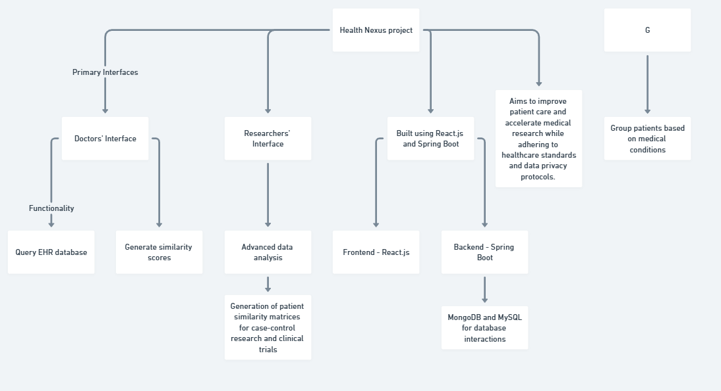
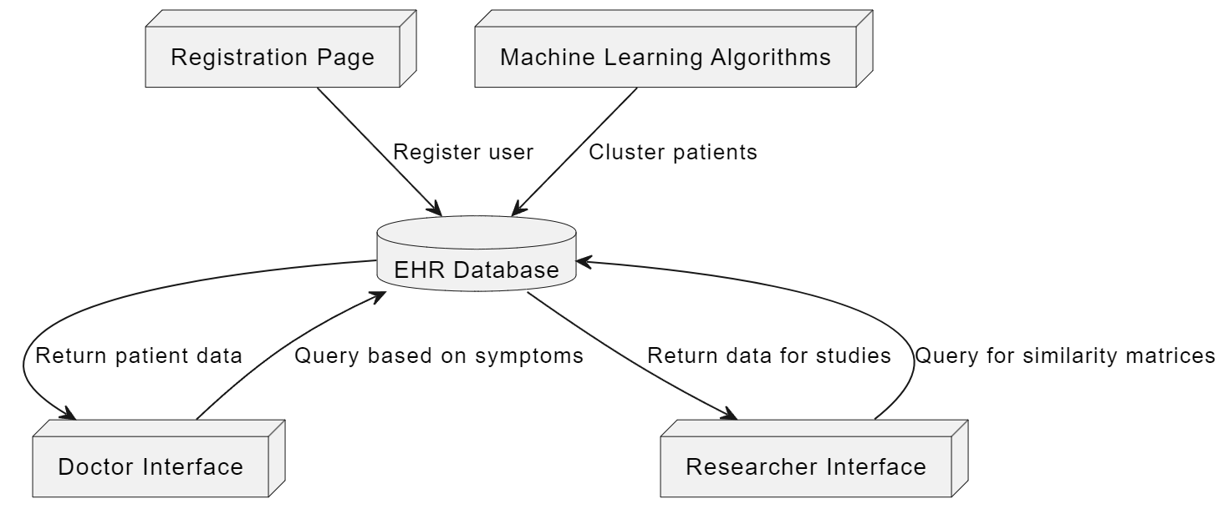
Architecture

Slide 11
Hardware/software components
Backend:
Programming Language: Java
Framework: Spring
Database: PostgreSQL, MongoDB
Frontend: HTML,CSS
Framework: React.js
Bootstrap
UI/UX Design: Design intuitive and user-friendly interfaces for both researchers and doctors.
Machine Learning:
Libraries: Scikit-learn, TensorFlow, or PyTorch
Clustering Algorithms: GMM

Slide 12
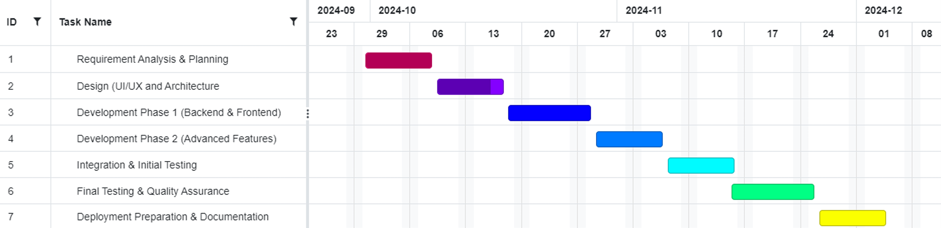
Timeline of Project

Slide 13
Expected Outcomes
The application will enable doctors to make more informed diagnoses and treatment plans by providing accurate, real-time patient similarity scores.
Researchers will benefit from advanced querying capabilities and similarity score matrices for clinical trials.

Slide 14
Conclusion
The proposed solution will enhance the efficiency of both clinicians and researchers by integrating machine learning with EHR systems. This will improve patient care, streamline research efforts, and contribute to the broader field of healthcare technology.

Slide 15
Github Link
The Github link provided should have public access permission.
Github Link :- repo:harsha-biradar/CapstoneProject

Slide 16
References
1. Smith, J., Johnson, E., & Green, M. (2021). Applications of machine learning in healthcare: Patient similarity and predictive modeling using EHR data. Journal of Medical Informatics, 35(2), 101-117. https://doi.org/10.1016/j.jmi.2021.01.001
2. Brown, S., & Davis, K. (2019). Clustering algorithms for healthcare: An overview and practical applications in patient grouping. Health Data Science Review, 18(3), 45-62. https://doi.org/10.1016/j.hdsr.2019.03.002
3. White, L., & Thompson, D. (2020). Electronic health records and machine learning: Improving patient diagnosis and treatment recommendations. Journal of Healthcare Analytics, 10(4), 213-230. https://doi.org/10.1016/j.jha.2020.10.005
4. Taylor, J., & Moore, R. (2022). Patient similarity-based clinical decision support systems: Methods and challenges. Journal of Medical Systems, 46(1), 18-32. https://doi.org/10.1007/s10916-022-01701-4
5. Clark, J., & Wilson, A. (2023). Evaluation of patient similarity metrics for clinical research and decision making. Artificial Intelligence in Medicine, 67(1), 45-58. https://doi.org/10.1016/j.artmed.2023.05.008

Slide 17
References
https://doi.org/10.1016/j.eaai.2020.04.010
6. Miller, C., & Garcia, O. (2021). Predictive analytics in healthcare: Machine learning for risk stratification and patient clustering. Journal of Big Data and Healthcare, 15(4), 245-260. https://doi.org/10.1016/j.bdh.2021.11.009
7. Lewis, S., & Rogers, M. (2022). Clinical trial design using machine learning: Patient clustering for personalized interventions. Journal of Personalized Medicine, 12(2), 120-138. https://doi.org/10.3390/jpm12020078
8. Mitchell, K., & Parker, T. (2020). Ethical considerations in machine learning for healthcare: Bias, privacy, and fairness in EHR-based models. Ethics in AI, 28(3), 100-115. https://doi.org/10.1016/j.eaai.2020.04.010
9. Adams, B., & Howard, E. (2019). From data to decisions: How electronic health records and AI can transform clinical practices. Journal of AI in Medicine, 24(1), 66-80. https://doi.org/10.1016/j.jaim.2019.01.006
10. Evans, P., & Scott, L. (2023). Root mean squared error (RMSE) as a metric for evaluating similarity scores in patient clustering models. Journal of Applied Statistics in Healthcare, 20(5), 102-119. https://doi.org/10.1016/j.jash.2023.08.012

Slide 18

Project work mapping with SDG
SDG 3: Good Health and Well-being
SDG 16: Peace, Justice, and Strong Institutions

Slide 19
Thank You

